Slide 1
Association Network Construction and Application
Keyang Zhang
ADAPT Lab
Supervised by Kenny Q. Zhu

Slide 2
Free Association Norms
Cue | Response | Strength
river | lake | 15/150
river | stream | 15/150
river | water | 9/150
river | flow | 8/150
river | boat | 7/150
river | canoe | 7/150

Slide 3
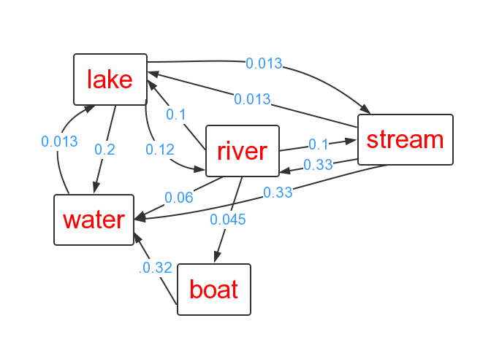
Free Association Network

Slide 4
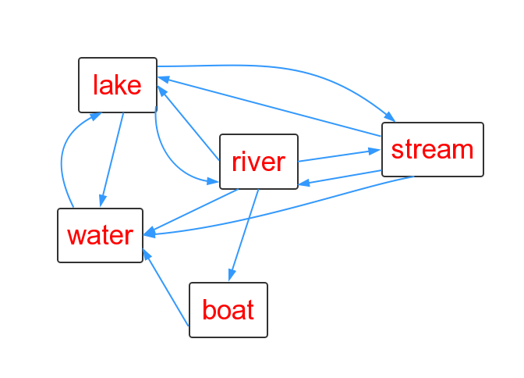
Synthetic Association Network

Slide 5
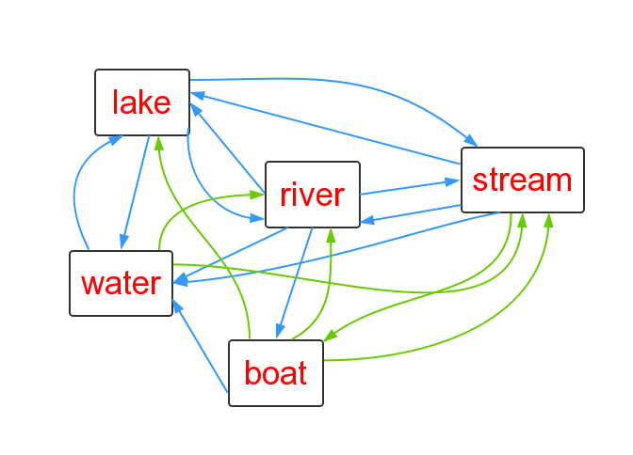
Synthetic Association Network

Slide 6
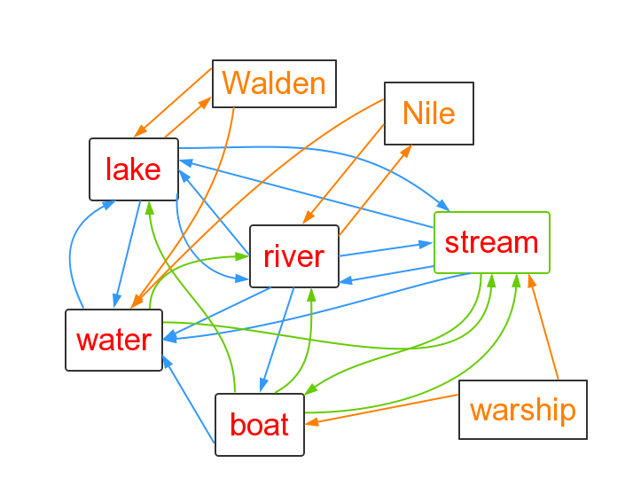
Synthetic Association Network

Slide 7
Application : Semantic Relatedness
Term1 | Term2 | Score
car | automobile | 8.94
car | train | 6.31
car | drink | 3.04

Slide 8
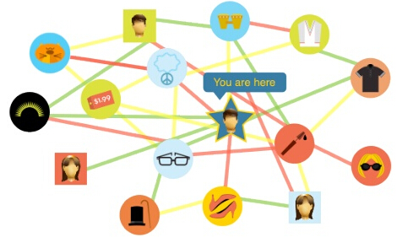
Application : Recommender System

